Slide 1

Data Pre-processing

Slide 2
Steps of Data Pre-processing
Missing value treatment
Outlier treatment
Feature scaling
Encoding

Slide 3
Missing value treatment
Name | Weight | Gender | Play Cricket
John | 65 | M | Y
James | 58 | M | Y
Scarlet | 45 | F | N
Sylvia | 65 |  | Y
Mathew | 76 | M | N
Andrea | 45 | F | Y
Cynthia | 54 |  | Y
Andrew | 67 | M | N
Name | Weight | Gender | Play Cricket
John | 65 | M | Y
James | 58 | M | Y
Scarlet | 45 | F | N
Sylvia | 65 | F | Y
Mathew | 76 | M | N
Andrea | 45 | F | Y
Cynthia | 54 | F | Y
Andrew | 67 | M | N
Gender | #Players | #Play Cricket | %Play Cricket
F | 2 | 1 | 50%
M | 4 | 2 | 50%
Missing | 2 | 2 | 100%
Gender | #Players | #Play Cricket | %Play Cricket
F | 4 | 3 | 75%
M | 4 | 2 | 50%

Slide 4
Missing value treatment
Remove when the percentage more than 25
For Categorical Data
Populate the data using mode
For Numerical Data
Populate the data using mean
Populate the data using median

Slide 5
Missing value treatment
Apply K-Nearest Neighbour
Student_Id | Marks_10 | Marks_12 | Marks_Grad | State | Salary
1 | 45 |  | 56 | 1 | 10000
2 |  | 65 | 67 | 1 | 12000
3 | 54 | 68 | 57 | 0 | 14000
4 | 89 | 88 |  |  | 18000
5 |  | 87 | 84 | 1 | 21000

Slide 6
K-Nearest Neighbour
Student_Id | Marks_10 | Marks_12 | Marks_Grad | State | Salary
1 | 45 |  | 56 | 1 | 10
2 |  | 65 | 67 | 1 | 12
3 | 54 | 68 | 57 | 0 | 14
4 | 89 | 88 |  |  | 18
5 |  | 87 | 84 | 1 | 21
Choose a missing value to impute
Select the other values in that row
Choose the number if neighbours, we will set in the code
Calculate nan_Euclidean distance from all the other corresponding row elements

Slide 7
K-Nearest Neighbour
Student_Id | Marks_10 | Marks_12 | Marks_Grad | State | Salary
1 | 45 |  | 56 | 1 | 10000
2 |  | 65 | 67 | 1 | 12000
3 | 54 | 68 | 57 | 0 | 14000
4 | 89 | 88 |  |  | 18000
5 |  | 87 | 84 | 1 | 21000
$$dist\left(x,y\right)= \sqrt{wt ∗ {\left(x_{11}−x_{12}\right)}^{2}+{{(x}_{21}− x_{22})}^{2}+ ………}$$
Where wt = Total #of coordinates / # of present coordinates

Slide 8
Explanation
Student_Id | Marks_10 | Marks_12 | Marks_Grad | State | Salary
1 | 45 |  | 56 | 1 | 10
2 |  | 65 | 67 | 1 | 12
3 | 54 | 68 | 57 | 0 | 14
4 | 89 | 88 |  |  | 18
5 |  | 87 | 84 | 1 | 21
$$dist\left(x,y\right)= \sqrt{wt ∗ {\left(x_{11}−x_{12}\right)}^{2}+{{(x}_{21}− x_{22})}^{2}+ ………}$$
Where wt = Total #of coordinates / # of present coordinates

Slide 9
Outlier treatment
Student id | Marks
1 | 12
2 | 21
3 | 22
4 | 32
5 | 22
6 | 24
7 | 26
8 | 32
9 | 80
10 | 100
Student id | Marks
1 | 12
2 | 21
3 | 22
4 | 32
5 | 22
6 | 24
7 | 26
8 | 32
9 | 33
10 | 32

Slide 10
How to find outliers?

Slide 11
Q1 – 1.5IQR
23 – 1.5*3 = 18.5
Q1 – 1.5IQR
Quartile 1
Age
4
23
24
24
26
26
60
Inter Quartile Range
IQR Q3 – Q1
Q3 – Q1
26 – 23 = 3
Quartile 2 or Median
Quartile 3
Q3 + 1.5IQR
Q3 + 1.5IQR
26 + 1.5*3 = 30.5

Slide 12
Outlier treatment
Remove the outliers
Transform the data
Square root transformation
Cube root transformation
Log transformation

Slide 13
Encoding
State | Age | Salary | Purchase
California | 21 | 21000 | No
Texas | 25 | 25000 | No
Arizona | 23 | 25000 | Yes
Utah | 33 | 30000 | Yes
California | 45 | 35000 | Yes
California | 25 | 23000 | No
Texas | 26 | 27000 | Yes
Arizona | 27 | 29000 | No
Texas | 30 | 32000 | No
Texas | 32 | 31000 | Yes
Utah | 33 | 35000 | Yes
Utah | 34 | 40000 | Yes
Texas | 36 | 42000 | Yes
Texas | 34 | 35000 | No
State | Age | Salary | Purchase
1 | 21 | 21000 | No
2 | 25 | 25000 | No
0 | 23 | 25000 | Yes
3 | 33 | 30000 | Yes
1 | 45 | 35000 | Yes
1 | 25 | 23000 | No
2 | 26 | 27000 | Yes
0 | 27 | 29000 | No
2 | 30 | 32000 | No
2 | 32 | 31000 | Yes
3 | 33 | 35000 | Yes
3 | 34 | 40000 | Yes
2 | 36 | 42000 | Yes
2 | 34 | 35000 | No

Slide 14
One Hot Encoding
State | Age | Salary | Purchase
1 | 21 | 21000 | No
2 | 25 | 25000 | No
0 | 23 | 25000 | Yes
3 | 33 | 30000 | Yes
1 | 45 | 35000 | Yes
1 | 25 | 23000 | No
2 | 26 | 27000 | Yes
0 | 27 | 29000 | No
2 | 30 | 32000 | No
2 | 32 | 31000 | Yes
3 | 33 | 35000 | Yes
3 | 34 | 40000 | Yes
2 | 36 | 42000 | Yes
2 | 34 | 35000 | No
State_1 | State_2 | State_3 | State_4 | Age | Salary | Purchase
0 | 1 | 0 | 0 | 21 | 21000 | No
0 | 0 | 1 | 0 | 25 | 25000 | No
1 | 0 | 0 | 0 | 23 | 25000 | Yes
0 | 0 | 0 | 1 | 33 | 30000 | Yes
0 | 1 | 0 | 0 | 45 | 35000 | Yes
0 | 1 | 0 | 0 | 25 | 23000 | No
0 | 0 | 1 | 0 | 26 | 27000 | Yes
1 | 0 | 0 | 0 | 27 | 29000 | No
0 | 0 | 1 | 0 | 30 | 32000 | No
0 | 0 | 1 | 0 | 32 | 31000 | Yes
0 | 0 | 0 | 1 | 33 | 35000 | Yes
0 | 0 | 0 | 1 | 34 | 40000 | Yes
0 | 0 | 1 | 0 | 36 | 42000 | Yes
0 | 0 | 1 | 0 | 34 | 35000 | No

Slide 15
Feature scaling
State | Age | Salary | Purchase
California | 21 | 21000 | No
Texas | 25 | 25000 | No
Arizona | 23 | 25000 | Yes
Utah | 33 | 30000 | Yes
California | 45 | 35000 | Yes
California | 25 | 23000 | No
Texas | 26 | 27000 | Yes
Arizona | 27 | 29000 | No
Texas | 30 | 32000 | No
Texas | 32 | 31000 | Yes
Utah | 33 | 35000 | Yes
Utah | 34 | 40000 | Yes
Texas | 36 | 42000 | Yes
Texas | 34 | 35000 | No

Slide 16
Why Feature scaling?
K-Nearest Neighbour
K-Means
Hierarchical
PCA

Slide 17
Techniques of Feature scaling
Standardization
MinMax Scaler
Robust Scaler
MaxAbs Scaler
Power Transformer
Quantile Transformer
Normalization

Slide 18
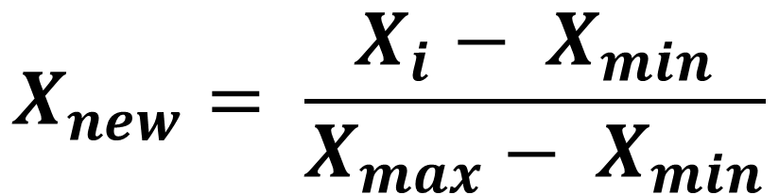
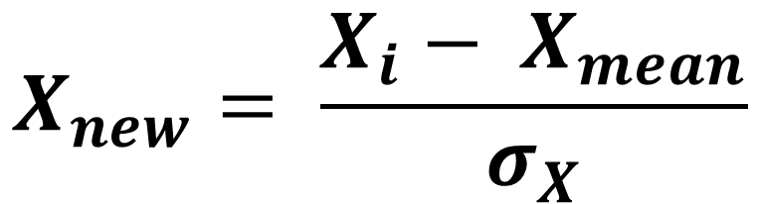
How to achieve Feature scaling?
Standardization
MinMaxScaler
$$X_{new}= \frac{X_{i}− X_{mean}}{σ_{X}}$$
$$X_{new}= \frac{X_{i}− X_{min}}{X_{max}− X_{min}}$$

Slide 19
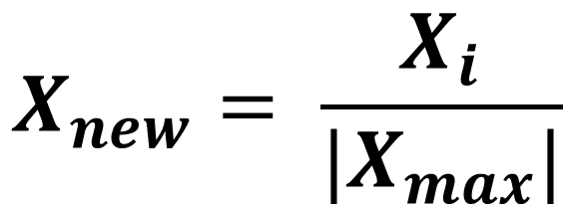
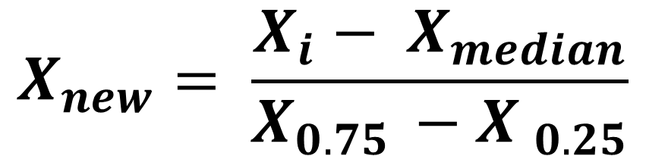
How to achieve Feature scaling?
RobustScaler
MaxAbsScaler
$$X_{new}= \frac{X_{i}− X_{median}}{X_{0.75 }−X _{0.25}}$$
$$X_{new}= \frac{X_{i}}{{|X}_{max}|}$$

Slide 20
How to achieve Feature scaling?
Normalization

Slide 21
Standardization
State | Age | Salary | Purchase
California | 21 | 21000 | No
Texas | 25 | 25000 | No
Arizona | 23 | 25000 | Yes
Utah | 33 | 30000 | Yes
California | 45 | 35000 | Yes

Slide 22
MinMaxScaler
State | Age | Salary | Purchase
California | 21 | 21000 | No
Texas | 25 | 25000 | No
Arizona | 23 | 25000 | Yes
Utah | 33 | 30000 | Yes
California | 45 | 35000 | Yes

Slide 23
RobustScaler
State | Age | Salary | Purchase
California | 21 | 21000 | No
Texas | 25 | 25000 | No
Arizona | 23 | 25000 | Yes
Utah | 33 | 30000 | Yes
California | 45 | 35000 | Yes

Slide 24
MaxAbsScaler
State | Age | Salary | Purchase
California | 21 | 21000 | No
Texas | 25 | 25000 | No
Arizona | 23 | 25000 | Yes
Utah | 33 | 30000 | Yes
California | 45 | 35000 | Yes

Slide 25
Normalization
State | Age | Salary | Purchase
California | 21 | 21000 | No
Texas | 25 | 25000 | No
Arizona | 23 | 25000 | Yes
Utah | 33 | 30000 | Yes
California | 45 | 35000 | Yes

